Slide 1

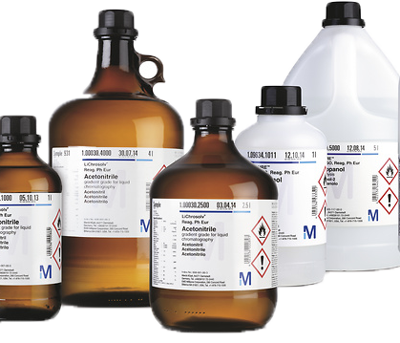
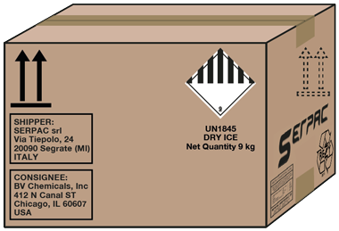










Non-Significant Administrative Changes for MDR/IVDR
SUPPLIER
PRODUCT
change of suppliers if material specifications don’t change
material #s for logistical reasons
outer packaging if no change to stability or sterility
MANUFACTURER
EU AUTHORIZED REP
QMS production
monitoring & controls
change to authorized representative
process validation for improvements or scale-up
merger or acquisition of manufacturer
name or address changes
(including suppliers, CMOs, new sites)
Notes:
MDCG 2022-6
4.2 Changes not concerning the design or intended purpose
Changes concerning the manufacturer’s organisation (administrative changes) or changes concerning the manufacturing process should generally not be considered changes in the design or intended purpose within the meaning of Article 110(3) IVDR, even if they need to be reflected in the information to be supplied with the device (e.g. label or instructions for use).
This includes for example:
• changes of the manufacturer’s name, address or legal form, including a merger or
acquisition involving the manufacturer;
• changes in relation to the authorised representative;
• relocation or addition of new manufacturing sites, including when it affects
subcontractors or suppliers;
• changing the supplier of a material, ingredient or component, provided the
specifications of the new material, ingredient or component do not change;
• adding or replacing a new material number for logistic reasons without changing the
material;
• changes to outer packaging (e.g. size, material, layout) that do not adversely affect
the stability, sterility or microbiological state of the device;
• new process validation as part of manufacturing improvements or scale-up of
manufacturing.
Changes of the QMS, such as changes in the monitoring and control of production and
operations environment, generally do not impact the design or intended purpose either,
provided that the conditions for which the conformity assessment certification was granted
are maintained.
4.3 Changes in the design or intended purpose
4.3.1 Design and intended purpose
As the devices that are placed on the market in accordance with the transitional provision
laid down in Article 110(3) IVDR need to be in compliance with Directive 98/79/EC, the
benchmark for determining their design and intended purpose, as well as any possible
change, should be the IVDD.
While the IVDD does not define the ‘design’ of a device, the ‘intended purpose’ means “the
use for which the device is intended according to the data supplied by the manufacturer on
the labelling, in the instructions for use and/or in promotional materials” (Article 1(2), point
(h), of the IVDD).
4.3.2 Significance of changes
Not all changes concerning the design or intended purpose would automatically have to be
regarded as ‘significant’. Whether or not a change is significant has to be assessed case by
case.
To facilitate a harmonised judgement of the significance of changes, this guidance document
provides several flowcharts in the Annex. The assessment of a proposed change using the
main flowchart and any of the applicable sub-charts is intended to assist manufacturers,
notified bodies and market surveillance authorities in deciding whether or not a change of the
design or intended purpose of the device is to be considered significant under IVDR Article
110(3).
A change is considered a non-significant change of design or intended purpose per IVDR
Article 110(3) if the answer to every question in a sub-chart leads to ‘non-significant change’
also when returning to the main chart. On the contrary, if any sub-chart delivers the result
‘significant change’, the change being assessed is a ‘significant change in design or intended
purpose’ according to the IVDR Article 110(3).
4.3.2.1. General considerations
As a general rule, the following changes in design and/or intended purpose should not be
regarded as ‘significant’:
• changes related to corrective actions assessed and accepted by the competent
authority (see also Q&A 15 of the CAMD’s FAQ – IVDR Transitional provisions
regarding design changes; the same approach should apply also to changes related
to the intended purpose)12;
correction of spelling mistakes or merely editorial changes of the information to be
supplied with the device (e.g. label or instructions for use);
• updates of the information to be supplied with the device (e.g. label or instructions for
use) if they are required by law other than the IVDR (e.g. CLP Regulation (EC)
1272/2008 read in conjunction with Annex I, section 8.3. IVDD) are mere clarifications
and do not adversely affect the devices’ safety and performance in relation to existing
or new risks.
4.3.2.2 Changes in the intended purpose – Chart A
Regarding changes of the intended purpose the following principles should apply (see
chart A):
Non-significant change:
• limitation of the intended purpose (see Q&A 15 of CAMD’s FAQ – IVDR Transitional
provisions), such as restricting the target population, specimen type, specimen
location.
Significant change:
• extension of the intended purpose, such as:
o additions regarding what is detected and/or measured, such as addition of a
new genotype to a human papillomavirus assay, necessitating new primers13;
o additional functions of the device, such as screening, monitoring, diagnosis;
o for companion diagnostics: extension of the target population(s) or of the
tissue type or associated medicinal products;
o addition of specimen type(s).
• any other major change of the intended purpose, such as:
o change of assay type, e.g. from screening assay to confirmatory assay or from
qualitative to quantitative assay;
o change of the intended user, e.g. from professional user to lay user;
o change of operation from automatic to manual or vice versa;
o change of specimen type(s).
When assessing whether the intended purpose is being changed, changes in the label or
instructions for use that are linked to the use for which a device is intended (e.g. limitations,
warnings) should be considered.
4.3.2.3 Changes in the design – Charts B to E
Changes concerning software, ingredients or materials, or sterilisation also concern the
design of the device. Specific flowcharts (C, D, E) are intended to assist in assessing
whether changes in those areas should be considered significant changes in the design.
Regarding changes of the design the following principles should apply (see chart B):
Non-significant change:
• changes of the design that do not alter the device’s operating principle14, that do not
adversely affect the safety or performance and that do not negatively affect the
risk/benefit ratio of the device:
o changes in incubation times and temperatures;
o changes in the processing steps of the method (e.g. a new washing step);
o use of a new PCR cycler which is more efficient in controlling the temperature;
o adding PCR cyclers from other producers as being compatible with a
particular PCR assay;
o change of the swab intended to be used with a device;
o replacement of the ELISA instrument;
o extension or reduction of shelf life of a non-sterile device15;
o change from refrigerated to room temperature storage conditions;
o change in internationally agreed reference values;
o change of instructions for use to refer to better precision of the device based
on data obtained as a result of post-market surveillance or addition of new
interfering or cross-reacting substances;
o clarifications of labelling or instructions for use;
o change of number of tests in the kit configuration.
Note: These examples are valid only provided that the change does not adversely affect
the safety or performance and that it does not negatively affect the risk/benefit ratio of the
device.
Significant change:
• changes that alter the device’s operating principle16:
Examples:
o change from immunofluorescence to ELISA;

