Slide 1
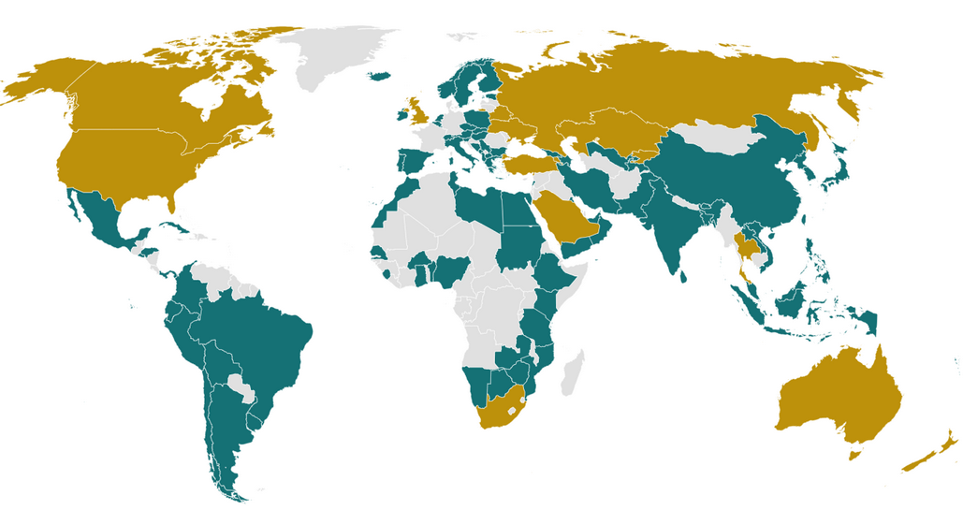
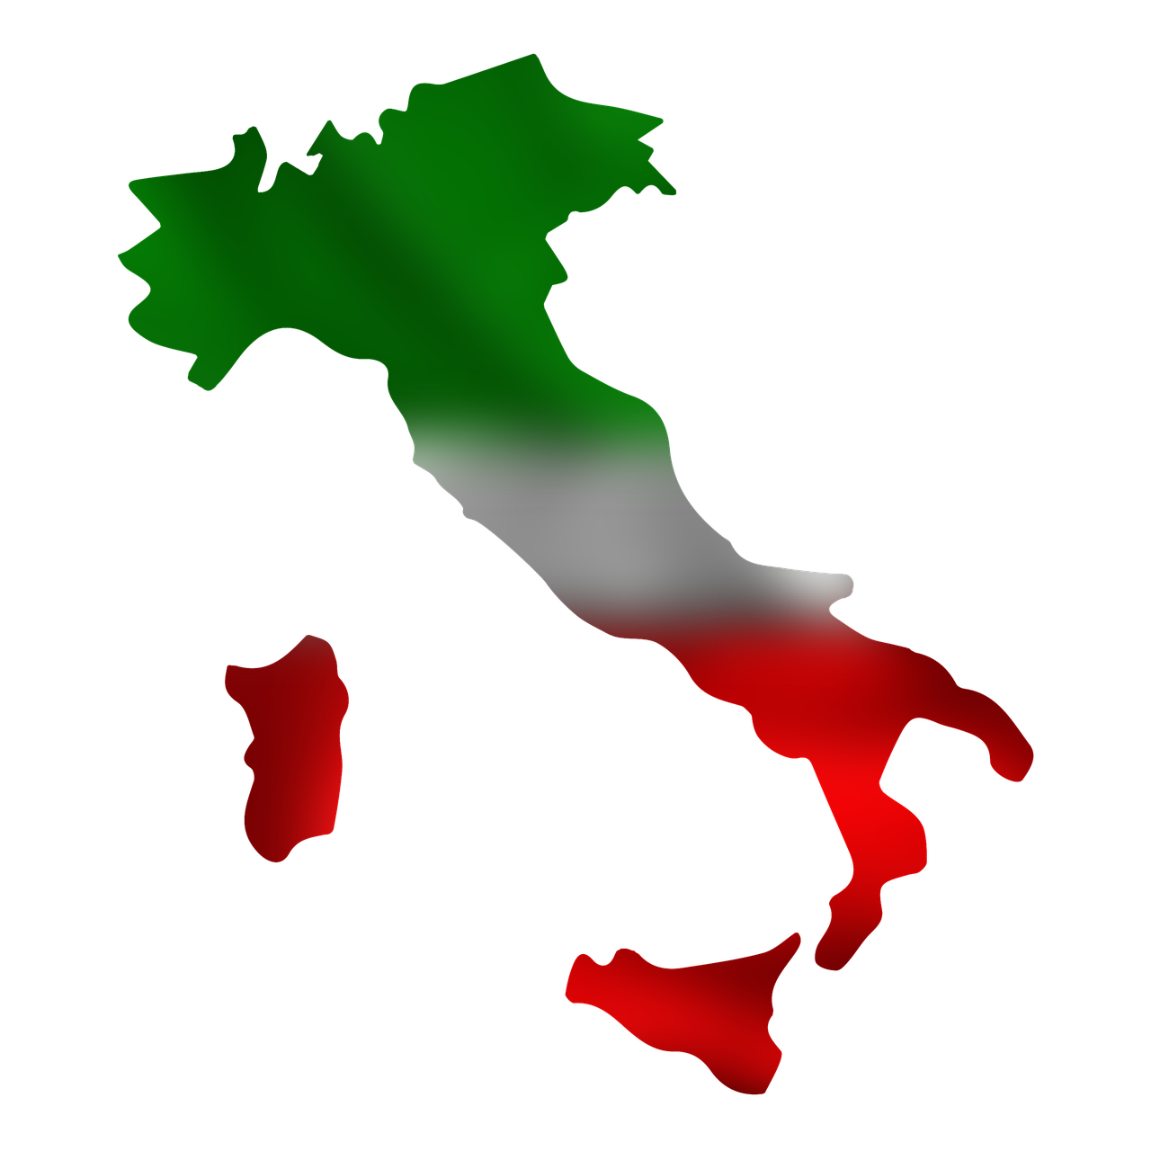
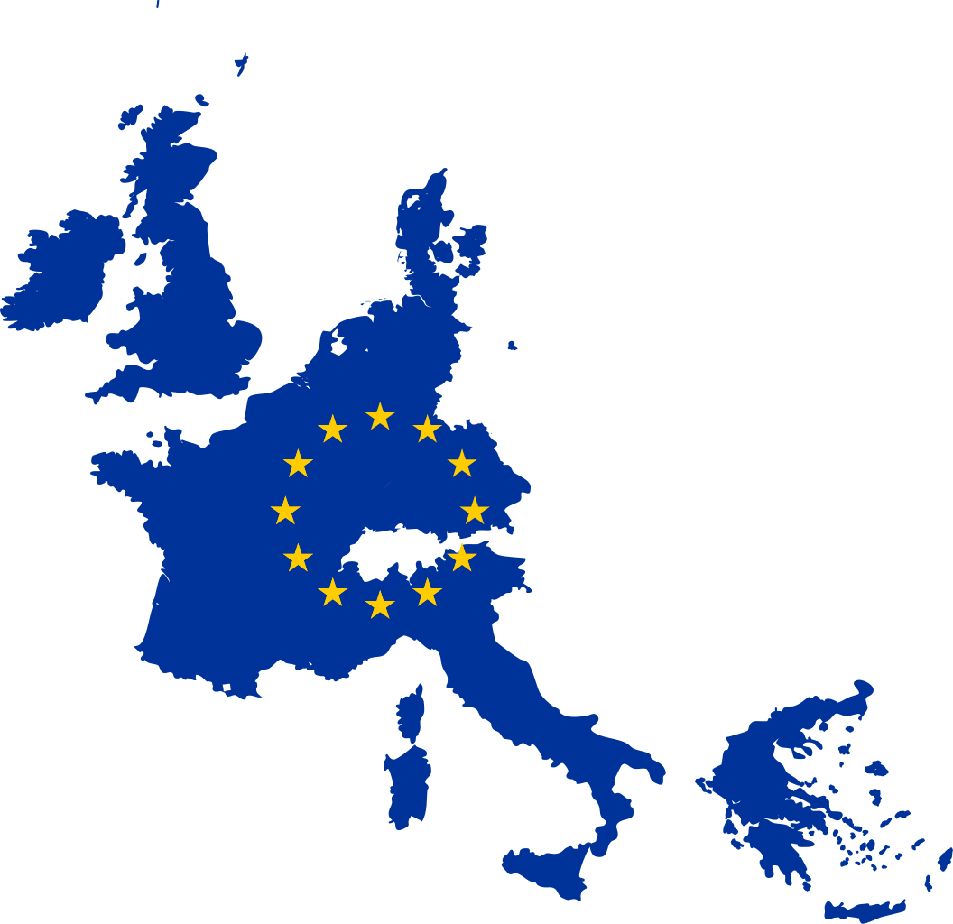

GMDN - CND - EMDN
❶ ISO creates, then most of world adopts Global Medical Device Nomenclature (GMDN)
❷ Italy creates National Classification of Medical Devices (CND)
❸ EU creates European Medical Device Nomenclature (EMDN) based on CND but maps to GMDN codes.

