Slide 1
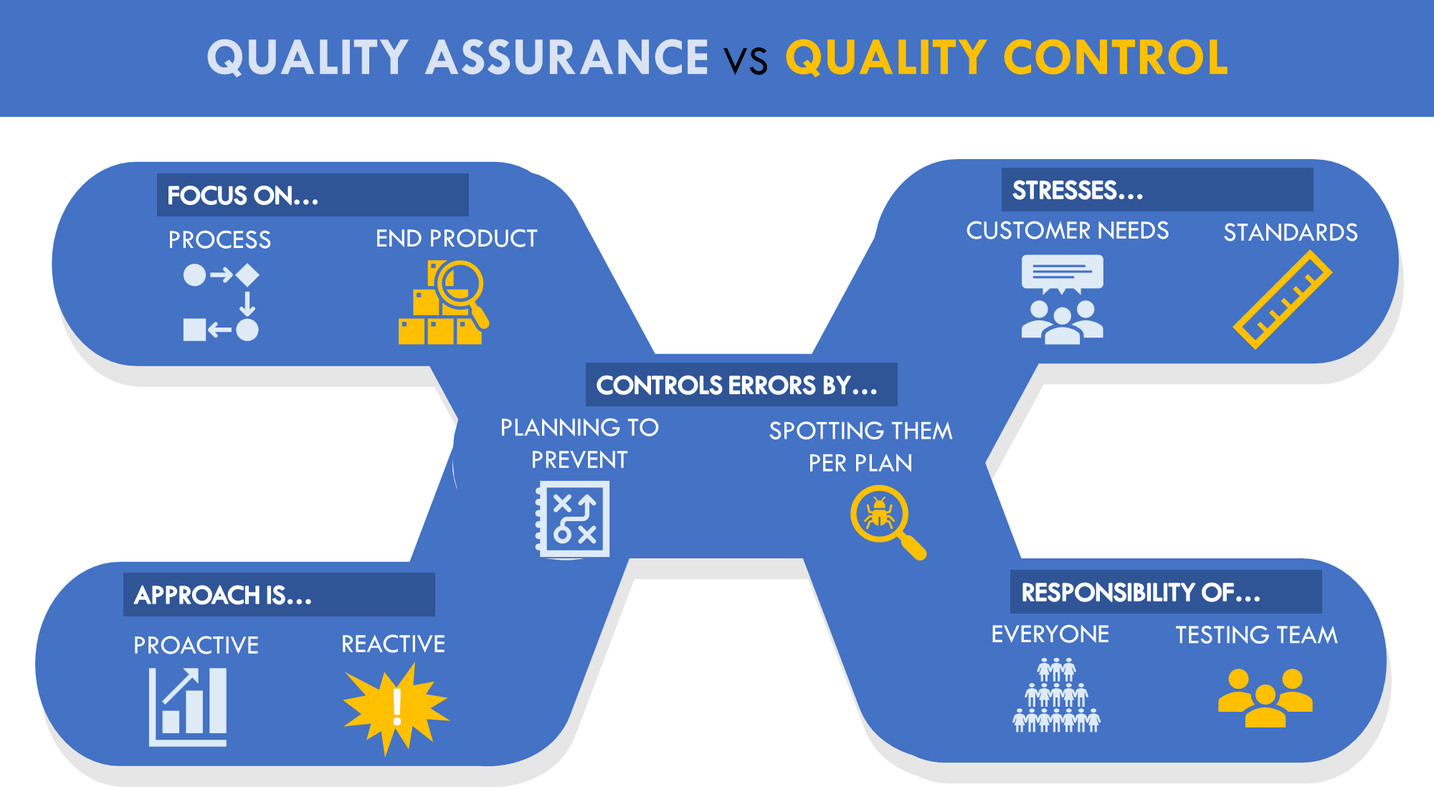









QUALITY ASSURANCE VS QUALITY CONTROL
FOCUS ON…
STRESSES…
PROCESS
END PRODUCT
CUSTOMER NEEDS
STANDARDS
CONTROLS ERRORS BY…
PLANNING TO PREVENT
SPOTTING THEM PER PLAN
APPROACH IS…
RESPONSIBILITY OF…
PROACTIVE
REACTIVE
EVERYONE
TESTING TEAM
!

