Slide 1
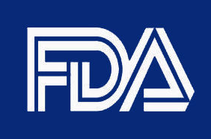


Used in Clinical Trial
Current
FDA cleared or approved use
In Vitro Diagnostic (IVD)
Investigational Device
Exempt, Non-significant Risk, or Significant Risk
Plans for Future
FDA cleared or approved use
No Plans for Future
FDA clearance or approval
Clinical Trial Assay (CTA)
Laboratory Developed Test (LDT)
Used for Patient Management Decisions
WHAT IS IT?

