Slide 1

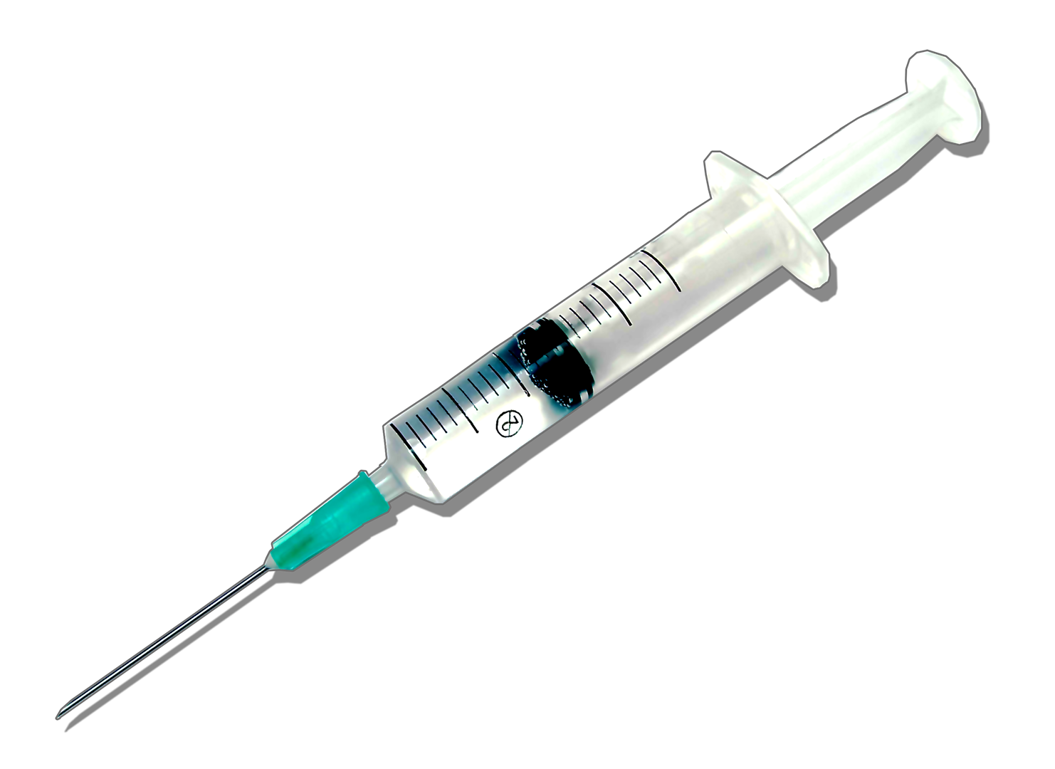

DRUG
DEVICE
BIOLOGIC
COMBINATION
PRODUCT
Notes:
Combination Product: a product composed of any combination of a drug, a device, and a biological product. (21 CFR Part 3)

