Slide 1

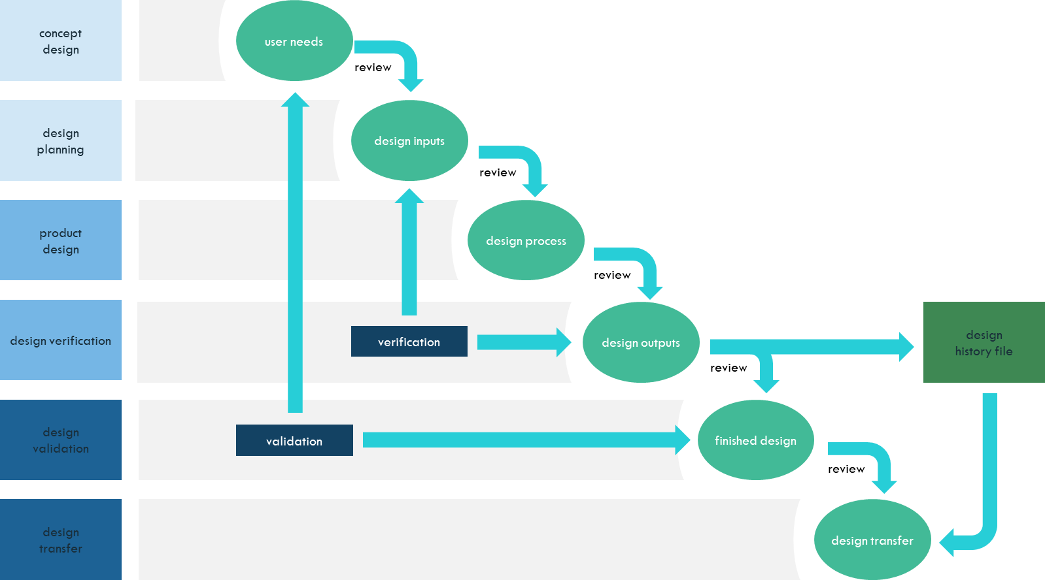

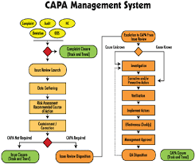






21 CFR PART 820
Management Responsibility:
Is quality system effective? Sufficient resources?
Design Controls:
Did we build the right thing? Did we build it right?
Customer Needs/ Satisfaction:
Complaints? Adverse events? Feedback?
Process Controls:
Are we in control?
Corrective & Preventive Actions:
Processes and controls are monitored to determine if they are effective. Data is reviewed, analyzed, and acted upon.
Materials…
Purchasing Controls
Material Controls
Traceability
Mother Nature
Facility
Controls
Methods…
Production
Controls
Document & Record Controls
Measurements…
Acceptance Controls
Man…
Personnel &
Training Contracts
Machines…
Equipment
Notes:
21 CFR Part 820, also known as the Quality System Regulation (QSR), is a document that outlines Current Good Manufacturing Practice (CGMP) regulations. This document governs manufactures to help ensure their products consistently meet applicable requirements and specifications. FDA 21 CFR Part 820 is the quality system approved by the FDA. These requirements are to ensure that medical devices are both safe and effective. Medical device manufacturers undergo FDA inspections to ensure FDA 21 CFR 820 compliance.

